Slide 1




An Empirical Study on the Permissioned Blockchain Evaluation -- Zeshun Shi Supervisor: Zhiming Zhao

Slide 2
Contents
Experiment background
Experiment Setup and assumptions
Experiment Result
Performance extensibility
Performance Stability
Resource Consumption
Future work

Slide 3





Experiment background
Permissionless Blockchain
Anyone can join the network and validate the blocks
Totally decentralized
Inefficient & energy-consuming (mining)
Expensive (Token e.g. Ether consumption)
Permissioned Blockchain
Requires identification (suitable for enterprise usage)
Partial decentralized
More efficient performance
Free to use
3
Notes:
Permissionless vs. Permissioned Blockchain

Slide 4














Experiment background
GAP: 1. Infrastructure fast Provisioning
2. Automated customization & performance profiling
Many blockchain platforms.
Hard to compare and profile due to the immutable nature.
Different configurations parameters and consensus algorithms.
Applications
Different cloud providers.
Manually configure.
Centralized BaaS model: vendor lock-in and single point of failure.
Blockchain Infrastructure
Cloud Infrastructure

Slide 5
Experiment Setup
Performance Extensibility: explore the blockchain performance under different transaction input patterns.
Performance Stability: test the distribution and stability of performance under the same transaction input rate.
Resource Consumption: discuss the CPU utilization and memory consumption of different blockchain platforms.

Slide 6

Experiment Setup
Linear Rate
Fixed Rate
Simulate Workloads
Performance
Resource Consumption
*Private Deployment
Visualization & Dashboard
Deploy Network
MacBook Pro
2.9 GHz Intel
Core i5 CPU and 16 GB DDR3 memory

Slide 7
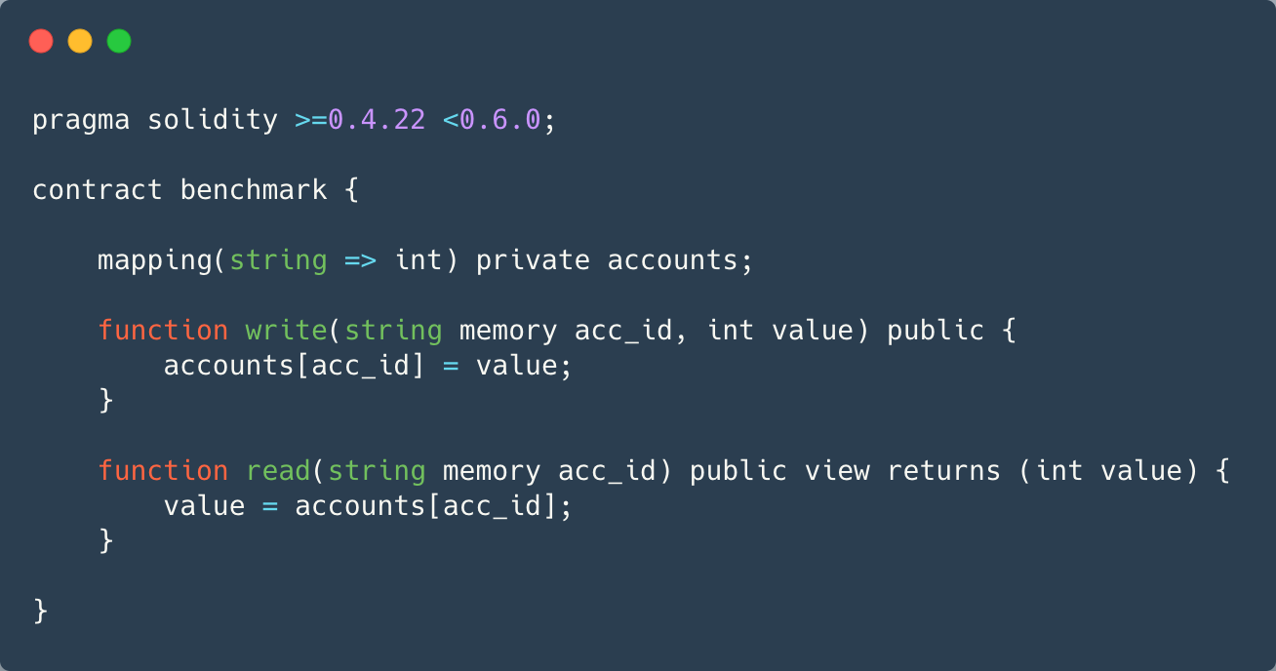
Experiment Setup
The same smart contract was leveraged to benchmark 5 blockchain platforms.
The functions of this smart contract include generating new transactions (writing) and querying existing transactions (reading).

Slide 8
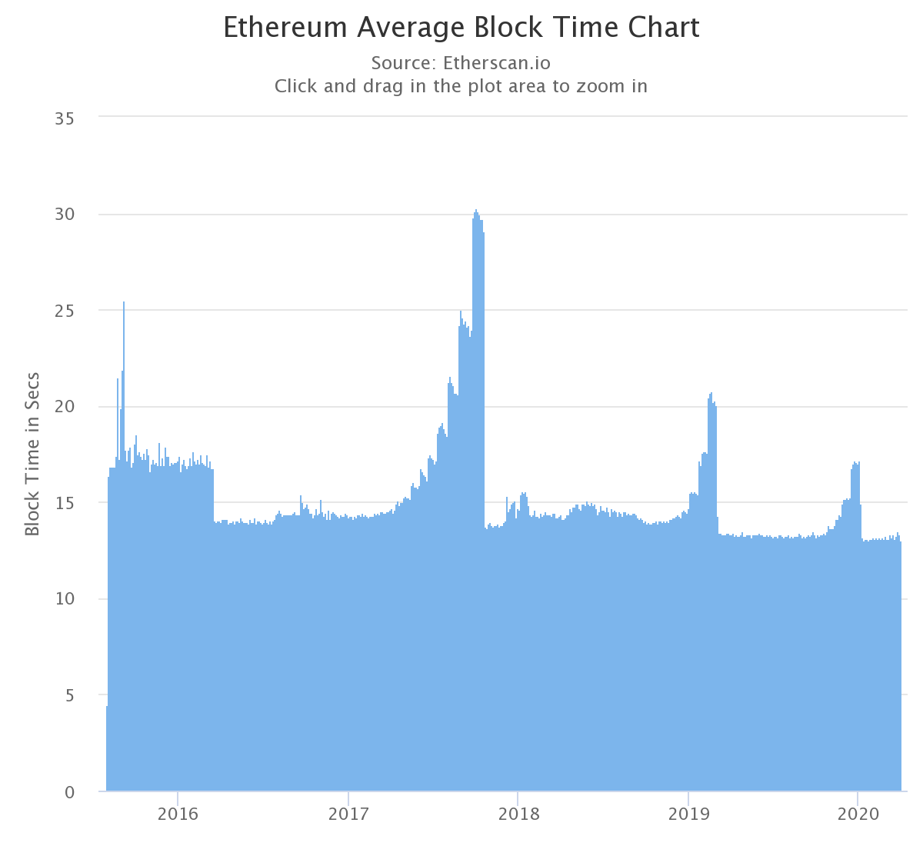
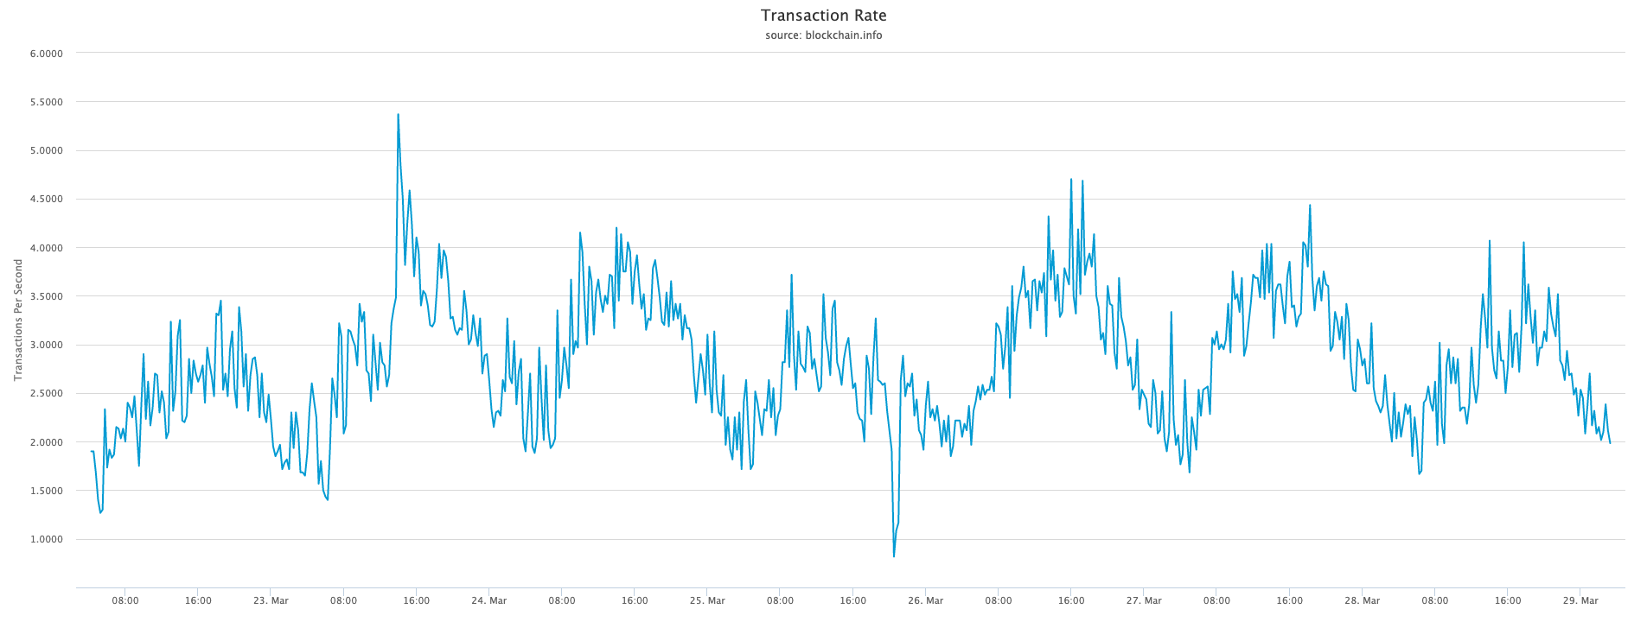
Experiment Assumptions
We would not discuss the performance of permissionless blockchain platforms because these data can be easily obtained from major monitoring websites.
Instead, our evaluation mainly focuses on the discussion of performance comparison of different permissioned blockchain platforms under the same scenario, which is lacking in most current studies.
Although different platforms have their own consensus algorithms, we believe that the impact of consensus algorithms on performance is limited by the framework itself.
This evaluation is mainly aimed at the comparison of different blockchain platforms and does not specifically discuss the comparison of consensus algorithms.
At the current stage, we only run blockchain networks on the local machine (docker-compose network) in order to compare their difference.
Next step we will consider deployment in the cloud or on-premises distributed clusters.

Slide 9
Experiment Result (Extensibility)
Trend: the write/read Throughput of different blockchain platforms will first increase and then reach its bottleneck
Bottleneck: Fabric has the highest write performance of 70 tps, and Iroha has the highest read performance bottleneck at around 200 tps. By contrast, Sawtooth has the worst overall performance, with write and read bottlenecks of about 13 tps and 60 tps, respectively.

Slide 10
Experiment Result (Stability)
Fabric has the most stable write transaction performance.
Although Sawtooth has the most stable read performance, its average throughput is very low.
In contrast, Fabric has both stable and the highest average read performance.

Slide 11
Experiment Result (Memory Consumption)
When the transaction rate increases, it is usually accompanied by an increase in memory consumption.
Ethereum consumes most memory consumption under our transaction patterns. (970 MB for write and 1280 MB for read)
Generally, read operation is more stable than write. (except for Ethereum)

Slide 12
Experiment Result (CPU Utilization)
Compared with the stable memory consumption, the CPU utilization of the different tends to be unstable.
Most platforms have higher CPU utilization when doing write operations, except for Ethereum.
Sawtooth has the most CPU usage (119% and 107% for write and read respectively), which means that the current transaction input volume has reached the performance bottleneck.
Iroha has the lowest CPU utilization, with write/read operations for only 25% and 5%.

Slide 13
Next Step
Building a Blockchain-based Decentralized Ecosystem for Cloud and Edge Computing (extend to a journal paper).
PhD: Performance profiling => Dapp DevOps.

Slide 14
Thank you! Questions?
https://articonf.eu/

